Slide 1
Part - I
Basic Terms and Concept:
Need for Security…
1) Authentication
2) Integrity
3) Confidentiality
4) Non-repudiation
5) Availability
6) Threat
7) Vulnerability
8) Risk
9) Security Control

Slide 2
Authentication
Who am I?
A
I am user A
B
C

Slide 3
Integrity:
Ideal route of the message
A
B
Transfer $100
to C
Transfer $1000
to C
C
Has the Message Changed?

Slide 4
Confidentiality
A
Secret
B
C
Has someone seen it?

Slide 5
Non-Repudiation
A
I never sent that message!
B
A sends a message and refutes it later

Slide 6
Availability
Availability is a characteristics of being accessible and usable during a specified time period.
In typical cloud environment, the availability of cloud services can be a responsibility that is shared by the cloud provider and cloud carrier.

Slide 7
Threat
A threat is a potential security violation that can challenge defenses in an attempt to breach privacy and/or cause harm.
Both manually and automatically instigated threats are designed to exploit known weaknesses, also referred as vulnerabilities.

Slide 8
Vulnerability
A vulnerability is a weakness that can be exploited either because it is protected by insufficient security controls, or because existing security controls are overcome by an attack.
IT recourse vulnerabilities can have a range have causes, including configuration deficiencies, security policy weaknesses, user errors, hardware or firmware flaws, software bugs and poor security architecture.

Slide 9
Risk
Risk is the possibility of loss or harm arising from performing an activity.
Two metrics that can be used to determine risk for an IT resources are:
1) The probability of a threat occurring to
exploit vulnerabilities in the IT resources.
2) The expectation of loss upon the IT
resource being compromised.

Slide 10
Security Controls
Security controls are countermeasures used to prevent or respond to security threats and reduced or avoid risk.
Security Mechanism
Countermeasures are typically described in terms of security mechanisms, which are components comprising a defensive frameworks that protects IT resources, information and services.

Slide 11
Threat Agents
Threat agent is an entity that poses a threat because it is capable of carrying out an attack.
Cloud security threats can originate either internally or externally, from humans or software programs.
1. Anonymous Attacker
2. Malicious Service Agent
3. Trusted Attacker
4. Malicious Insider

Slide 12
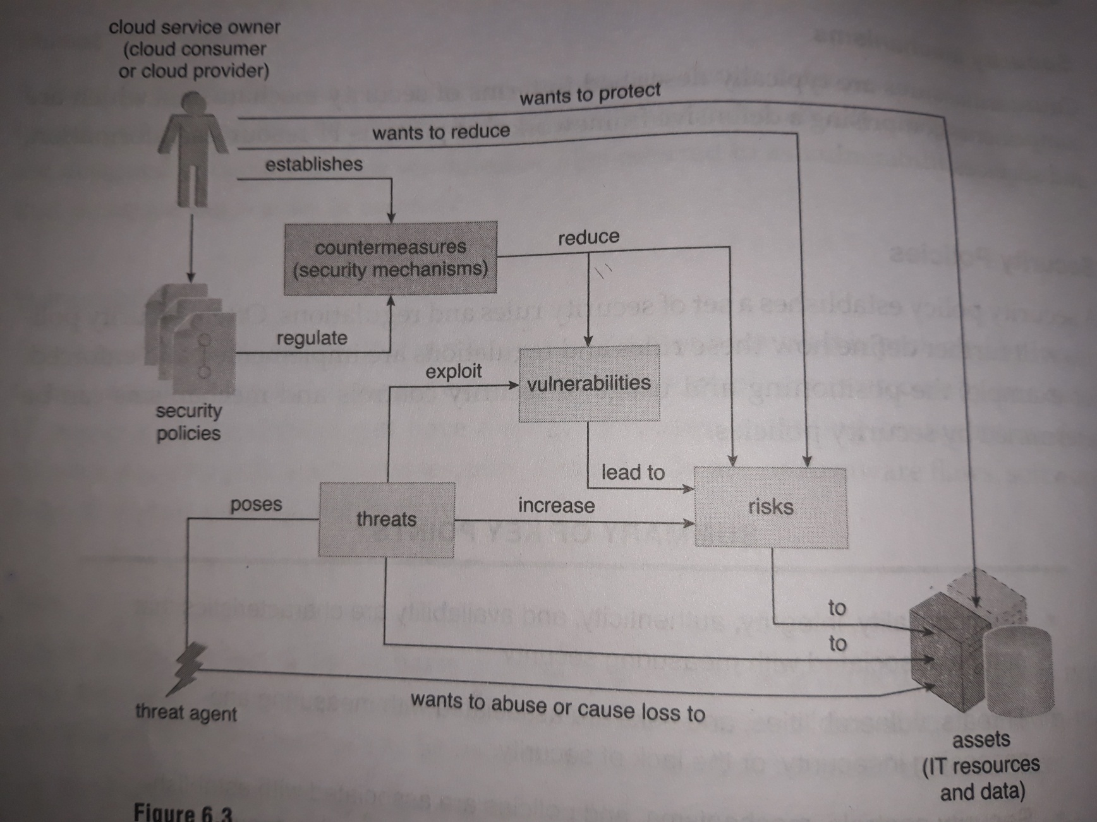
How security policies and security mechanisms are used to counter threats, vulnerabilities and risks caused by threat agents

Slide 13
6.1. Basic Terms and Concepts
Confidentiality
The characteristic of something being made accessible only to authorized parties.
Within cloud environments, confidentiality primarily pertains to restricting access to data in transit and storage.

Slide 14
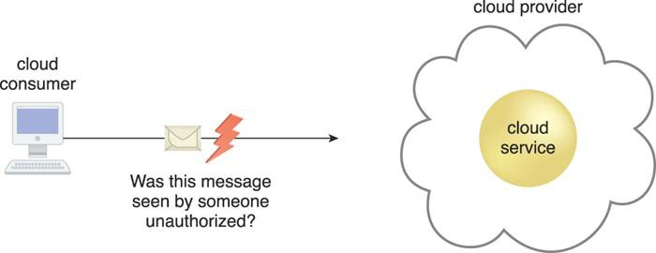
Confidentiality
Figure 6.1 The message issued by the cloud consumer to the cloud service is considered confidential only if it is not accessed or read by an unauthorized party.

Slide 15

Integrity
The characteristic of not having been altered by an unauthorized party .
An important issue that concerns data integrity in the cloud is whether a cloud consumer can be guaranteed that the data it transmits to a cloud service matches the data received by that cloud service.

Slide 16

Integrity
Figure 6.2 The message issued by the cloud consumer to the cloud service is considered to have integrity if it has not been altered.

Slide 17
Authenticity
The characteristic of something having been provided by an authorized source.

Slide 18
Availability
The characteristic of being accessible and usable during a specified time period.

Slide 19




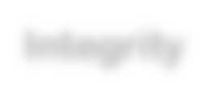
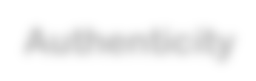









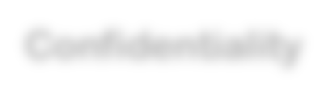

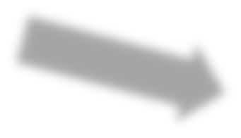


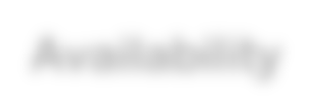

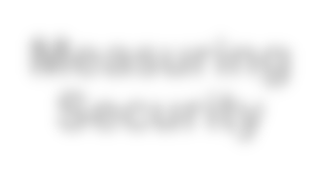
Integrity
Authenticity
Confidentiality
Availability
Measuring Security

Slide 20
Threat
A potential security violation that can challenge defenses in an attempt to breach privacy and/or cause harm.
Natural Threats(Floods or tornado)
Unintentional Threats(Employee Mistakenly accessing the wrong information)
Intentional Threats(Spyware, vmalware,…)

Slide 21
Vulnerability
A weakness that can be exploited either because it is protected by insufficient security controls, or because existing security controls are overcome by an attack.
A known Weakness.
e.g. team member resigns and company forget to disable their access.

Slide 22
Vulnerability
• Is your data backed up and stored in a secure off-site location?
• Is your data stored in the cloud? If yes, how exactly is it being protected from cloud vulnerabilities?
• What kind of network security do you have to determine who can access, modify or delete information from within your organization?
• What kind of antivirus protection is in use? Are the licenses current? Is it running as often as needed?
• Do you have a data recovery plan in the event of a vulnerability being exploited?

